Slide 1
Introduction to R and R Studio

Slide 2
Installing R and R Studio….
If you are on your own machine, you can download R and R studio here
https://posit.co/download/rstudio-desktop/
OR access here:
R is the language, R studio is the environment you run your code in

Slide 3
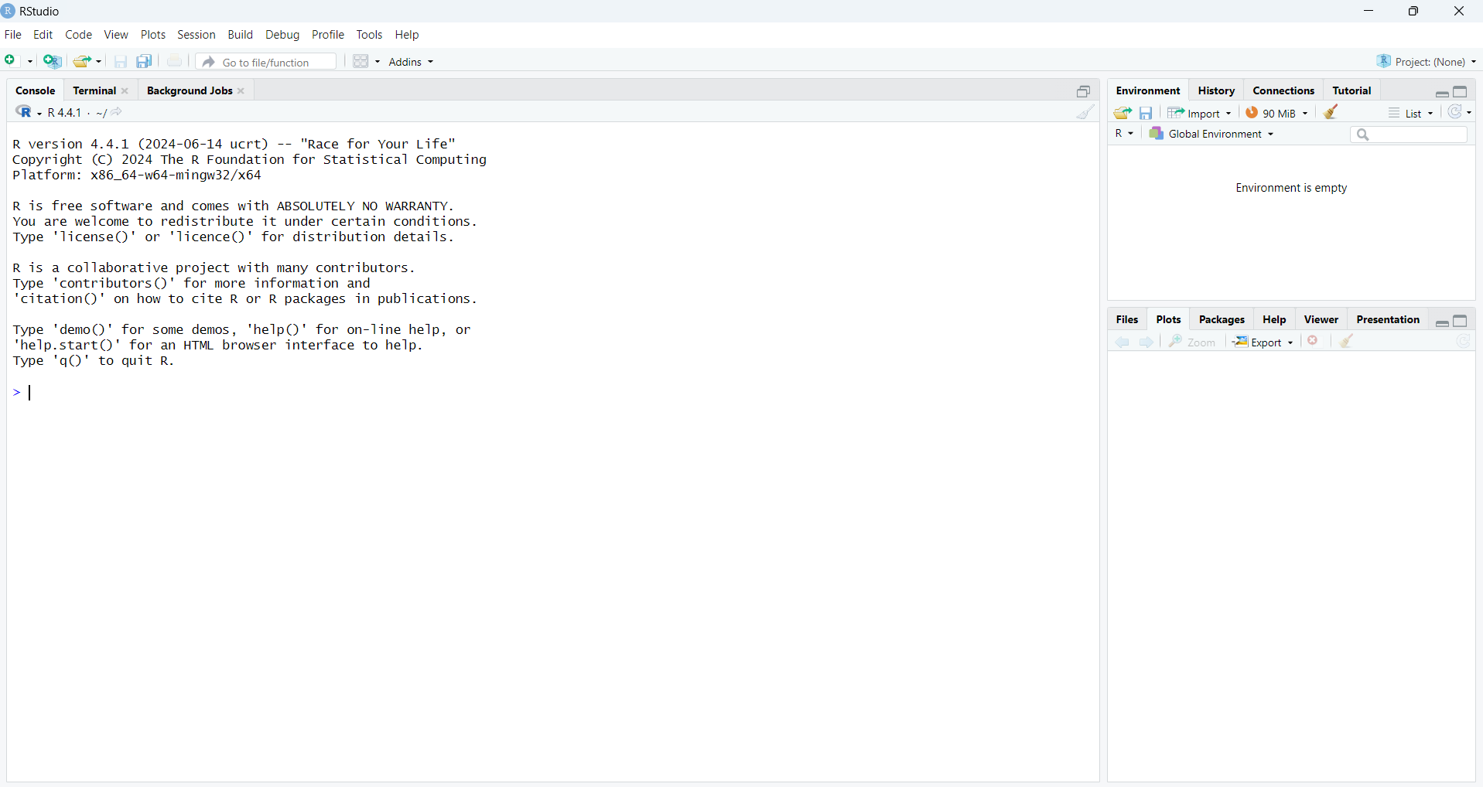

Slide 4
We can run code in the console. Try these:
2+2
5/2
x <- 2
x+2

Slide 5
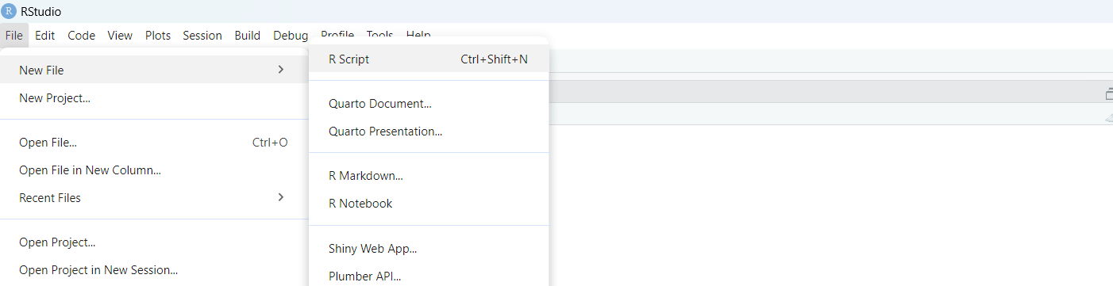
Better yet, let’s make a script so we can rerun code…
x <- 2
x+2
Write these lines into your new script

Slide 6
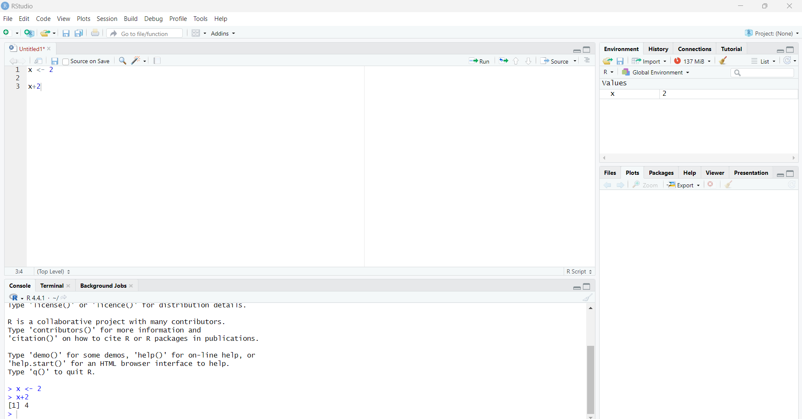
Run your code by clicking ‘Run’
Or highlight the line you want to run and press ‘CTRL’ + ENTER
X is now stored in our values at the top for use later
If you want to clear out your stored data here, click the sweepy brush
You can see the output in the console

Slide 7
Try these:
x^3
x * 5
y = x+6
Save your script, close down R studio, and reopen your script. You can now run this code whenever you want

Slide 8
Commenting code
To help other people (and our future selves) understand code, we can leave comments. These are written for humans, not the computer. In R we do this with
## at the start of a line
In your script add some comments.
Add ## at the start of the line
What happens when you try to run it?

Slide 9
Packages
R has lots of built in functionality, like we’ve just seen.
Sometimes we want to use other features which are built as add ons to R. These are called ‘packages’. The first time you use them, they need installing. After that, you need to run a function called library every time you use the package, to tell R that’s what you’re doing. We’ll use ggplot today.
install.packages("ggplot2”)
library(ggplot2)

Slide 10
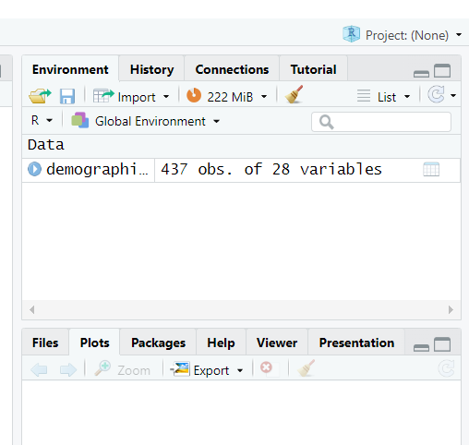
Data frames
Data frames store data – for now you can think of them like a table
We’re going to use a ggplot dataset called Midwest which contains demographic data from people in the Midwest
We’ll call our dataframe demographics
demographics <- Midwest
You can view data by clicking on demographics
Have a look at the data you’ve loaded.
Talk to the person next to you about what
information is in here

Slide 11
$notation….
Dataframe$column will bring us back all the results in that column. For example:
Demographics$poptotal will bring back all the total populations in the dataframe.
Can you write code to see all the adult populations?
Can you write code to see all the percentages of white people in each county?

Slide 12
Create a new variable
We know how much of the population is adults but not how much is children. Let’s say we want this number so we can work out how many schools to put in each county. We’re going to assume everyone who isn’t an adult, is a child. So we’ll make a new column in our data frame, popchildren = total population – adults
First we make the column and set to 0:
demographics$popchild <- 0
Then calculate the value
demographics$popchild <- demographics$poptotal - demographics$popadults

Slide 13
Saving data as a CSV – Now we have our extra column let’s save this as a CSV
We can save a dataframe to CSV using
write.csv()
But where will it save?
We first need to navigate R to a folder location by setting the working directory. We can do this with
setwd("/Your File Path/")
Or by using the ‘file’ option to navigate.
Then save the file :
write.csv(demographics, file="midwestDemographics.csv", row.names = FALSE)

Slide 14
Once you’ve saved your file, save your script and close down everything in R studio, quit R studio
Load your CSV:
demographicsCSV <- read.csv('midwestDemographics.csv',header=TRUE)
Is your new column still there? (Hopefully!!)

Slide 15
Plot a basic graph
Using ggplot we’ll plot our new child populations for each county
ggplot(data=demographicsCSV, aes(x=county, y=popchild))+ geom_bar(stat="identity")
Extension: Improve this graph using resources from the last session!

